Slide 1

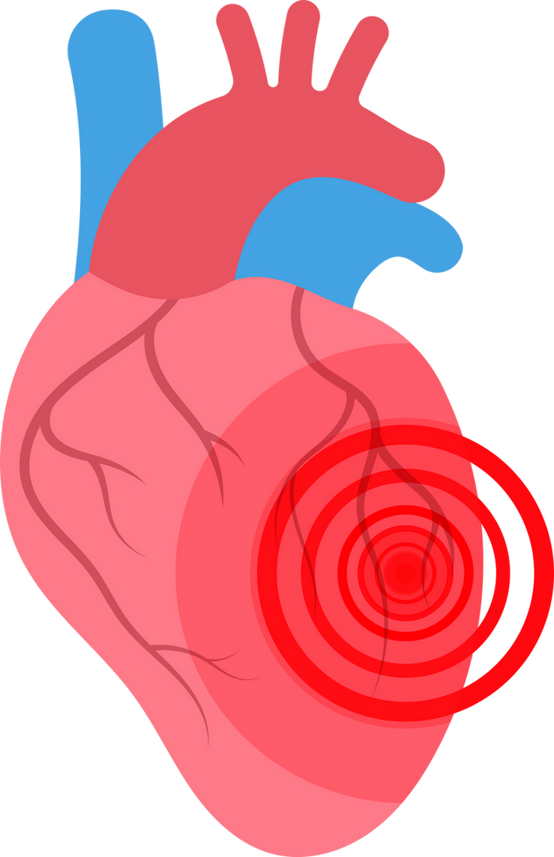



HEART FAILURE
prediction system

Slide 2

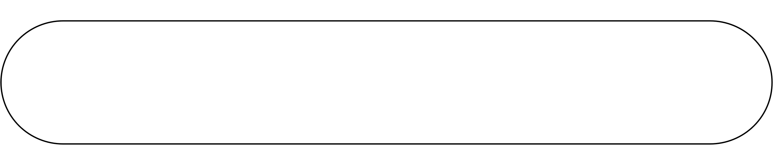
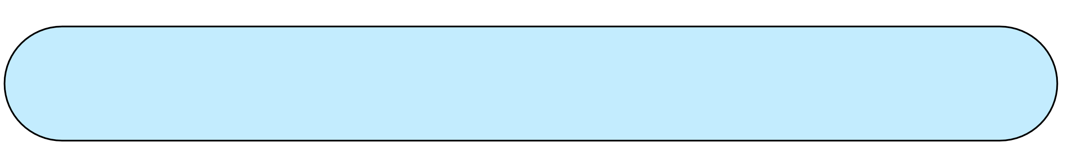
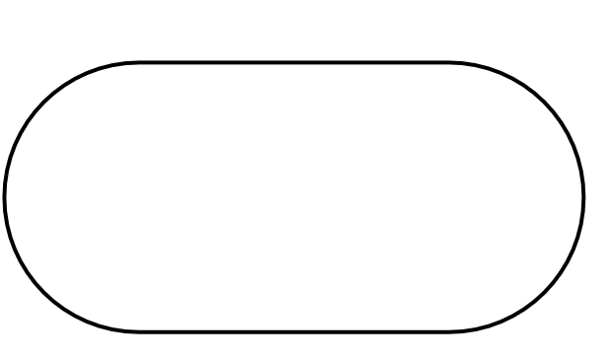
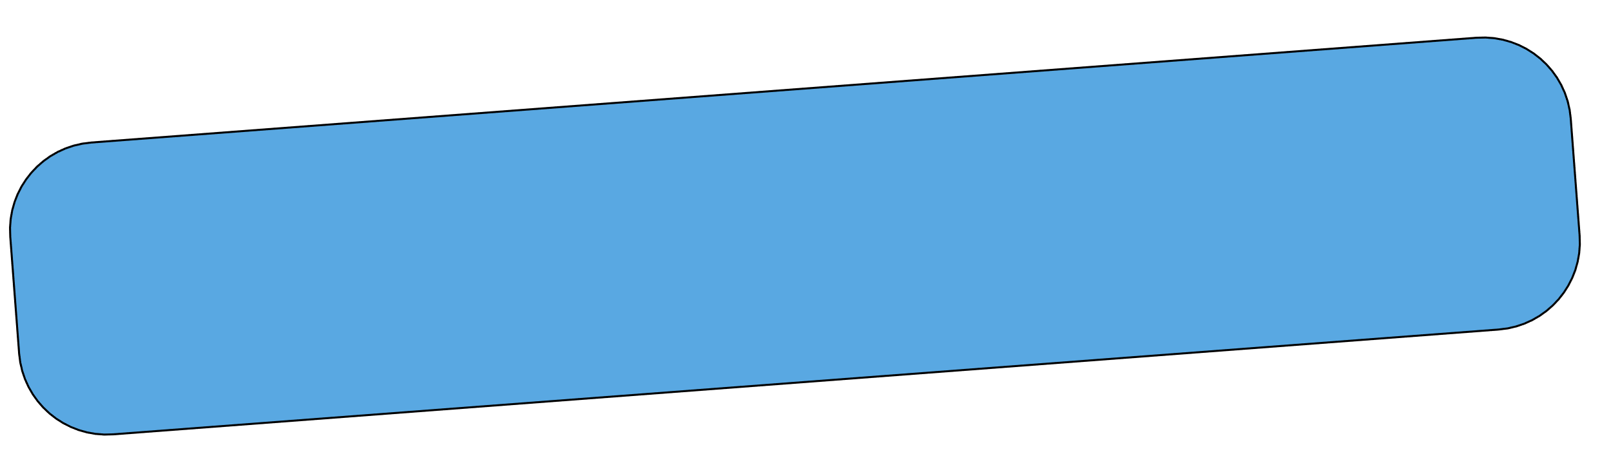
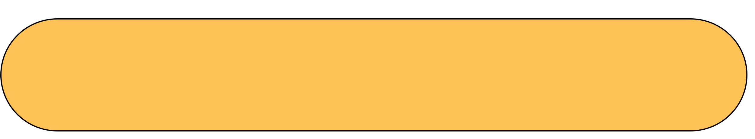
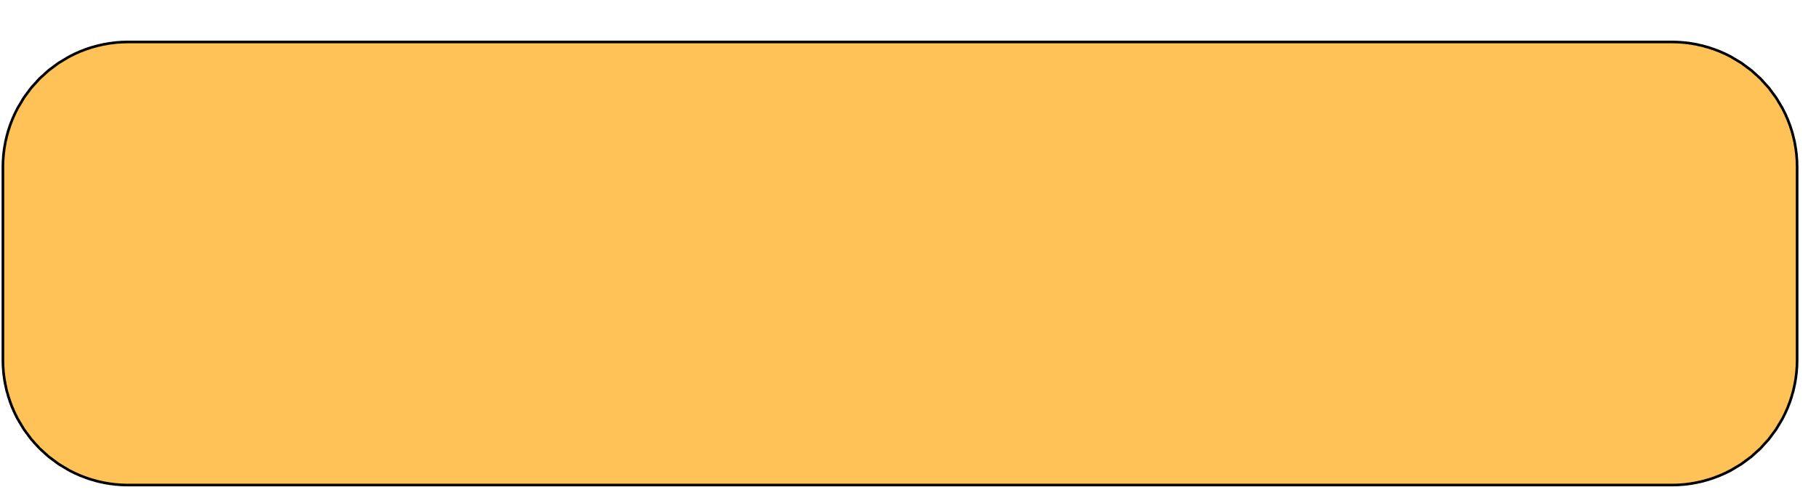

Team Members
Ahmed Mohamed Elroby
1
SUPERVISORS
Abanoub Emad Roshdy
2
Shaimaa Mohmed Zaki
3
Dr. Alaa Zaki
Ahmed Gomaa Saleh
4
Ahmed Samir Darwish
5
Eng. Rehab Abo Al-Hassan
Aya Mohamed Hassan
6
Alaa Nasser Mohamed
7

Slide 3


















Table Of Content
Abstract
Database Implementation
Data Visualization
Introduction
System Workflow
System Testing
Problem Statement
System Installation
Algorithm Selection
Project Objectives
Conclusion &
Future Work
GUI Design
Dataset Overview
System Implementation
References

Slide 4

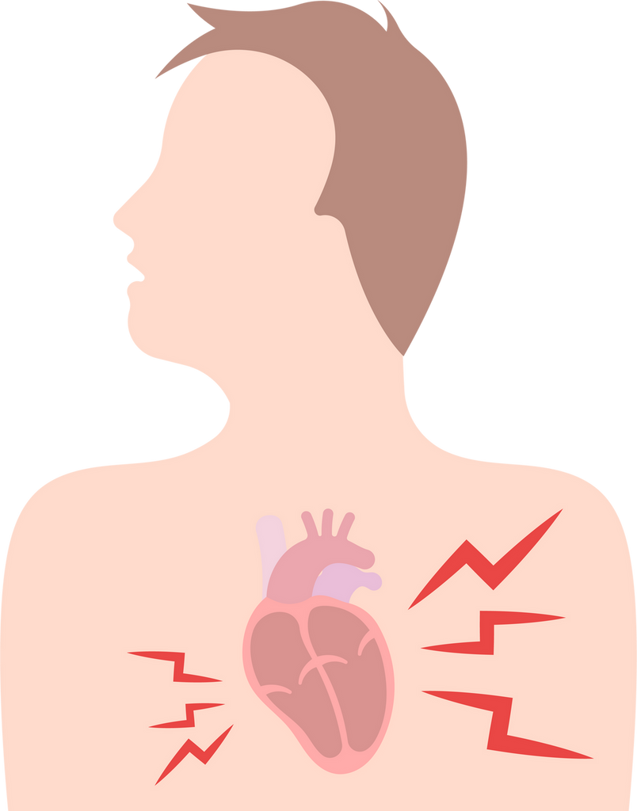

Abstract
AI-Based Prediction: Uses machine learning to assess heart failure risk.
Clinical Data Analysis: Factors include age, BMI, and physical health metrics.
Early Risk Identification: Helps doctors detect high-risk patients sooner.
Timely Interventions: Supports proactive healthcare decisions.
User-Friendly Interface: Bridges AI technology with real-world medical use.

Slide 5





introduction

Slide 6
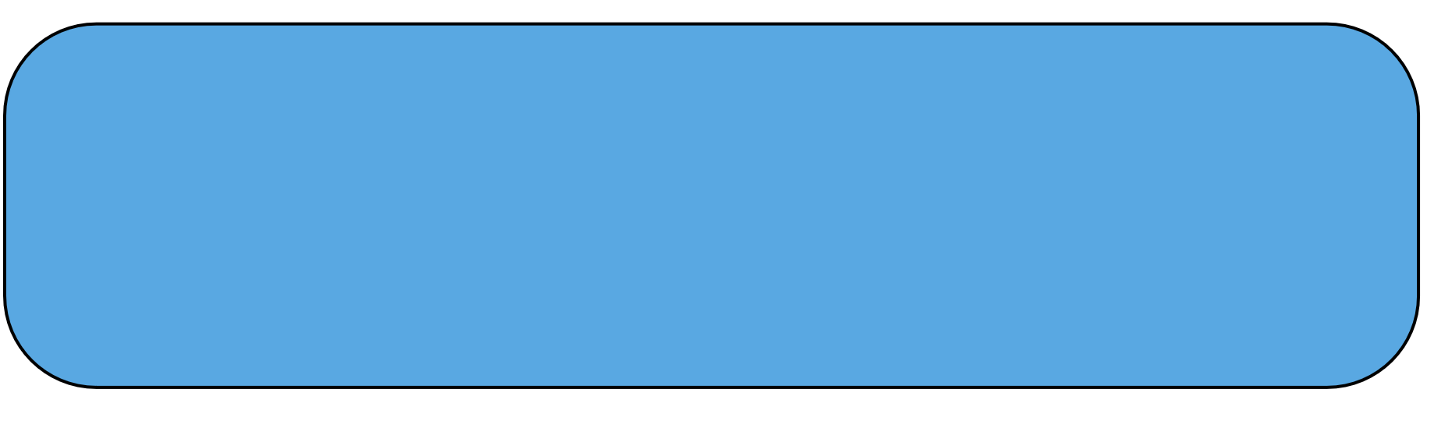




introduction to heart failure & solutions
Causes
Atherosclerosis is the most common cause. This is when fatty deposits build up in the arteries.
Symptoms
The symptoms of coronary artery disease include chest pains, chest tightness (angina), shortness of breath, neck pain and numbness in the legs or arms.
Solution
project leverages machine learning and data-driven techniques to provide a reliable solution for early risk prediction.

Slide 7
problem
statement

Slide 8





Problem
Statement
Limitations
Low accuracy leads to unreliable predictions.
Existing heart failure prediction systems lack accuracy, usability, and integration with clinical workflows, making them inadequate for healthcare providers. This project addresses these gaps by developing a reliable, user-friendly, and accessible system for early risk prediction, enhancing decision-making and patient care.
1
Systems are not user-friendly for healthcare providers.
2
Poor integration into clinical workflows.
3
Limited consideration of diverse patient data.
4

Slide 9
Project
Objectives

Slide 10



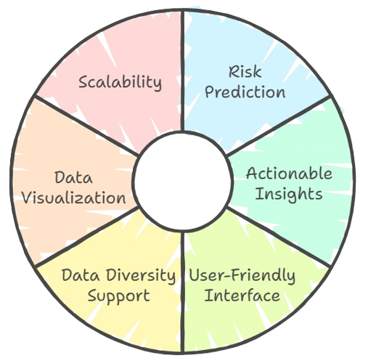







WHAT ARE THE OBJECTIVES OF PROJECT?
Predict heart failure risk using machine learning and clinical data.
Appreciate and celebrate differences in others
Use data visualization for better understanding of results.
Provide actionable insights to support early intervention.
Support diverse patient data to enhance accuracy.
Develop a user-friendly, web-based interface for seamless usage.

Slide 11
Dataset
Overview

Slide 12
Dataset overview
The dataset used in this project comes from Kaggle's Personal Key Indicators of Heart Disease (source). It contains 319,795 records and 18 features, covering key clinical and lifestyle factors such as Age, BMI, Alcohol Consumption, and Smoking Status. The dataset is well-structured with numerical and categorical data, making it suitable for machine learning models to predict heart failure risk accurately.

Slide 13







key features
12.02 to 94.85
BMI
AGE
20 to 80
YES
YES
HEART FALIURE
SMOKE
ASTHMA
NO
NO
YES
YES
ALCOHOLDRINKING
DIABETIC
NO
NO

Slide 14
Why This Dataset
Combines clinical and lifestyle factors for a holistic view of patient health.
Well-structured data suitable for machine learning models.
Provides actionable insights for healthcare professionals.

Slide 15









Some records lacked complete data, necessitating imputation or removal during preprocessing.
Missing Values
An uneven distribution of target classes (e.g., high-risk vs. low-risk patients) required techniques like oversampling to balance the data.
Data Imbalance
Extreme values in variables such as BMI and Age were identified and addressed to improve model reliability.
Outliers
CHALLENGES
Categorical variables like Smoking Status and Alcohol Consumption were converted into numerical formats for machine learning compatibility.
Feature Encoding
Normalization
Numerical features were scaled to ensure equal weight during model training.

Slide 16




Data
Visualization

Slide 17
Data Visualization
Data visualization plays a crucial role in identifying patterns and trends within the dataset. By using histograms, bar charts, and pie charts, key risk indicators for heart failure can be easily analyzed, helping to enhance the effectiveness of prediction models.

Slide 18
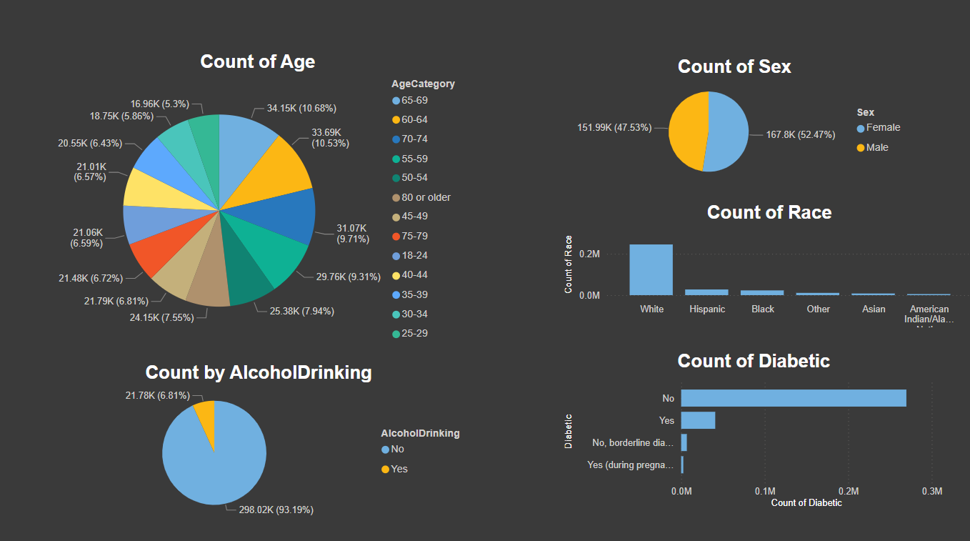

Slide 19
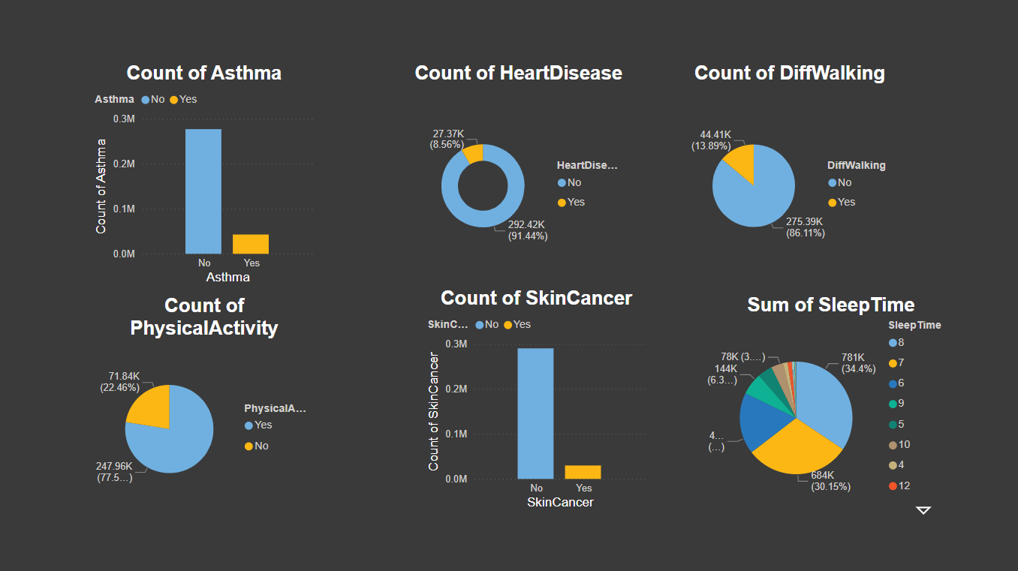
Notes:
1.7.2013
19
‹#›

Slide 20
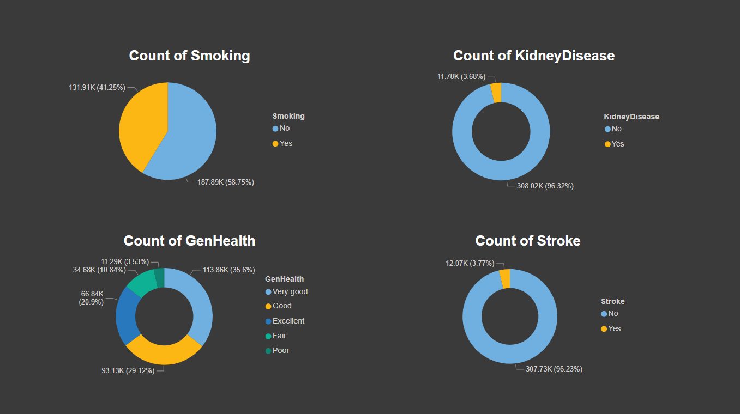


Slide 21
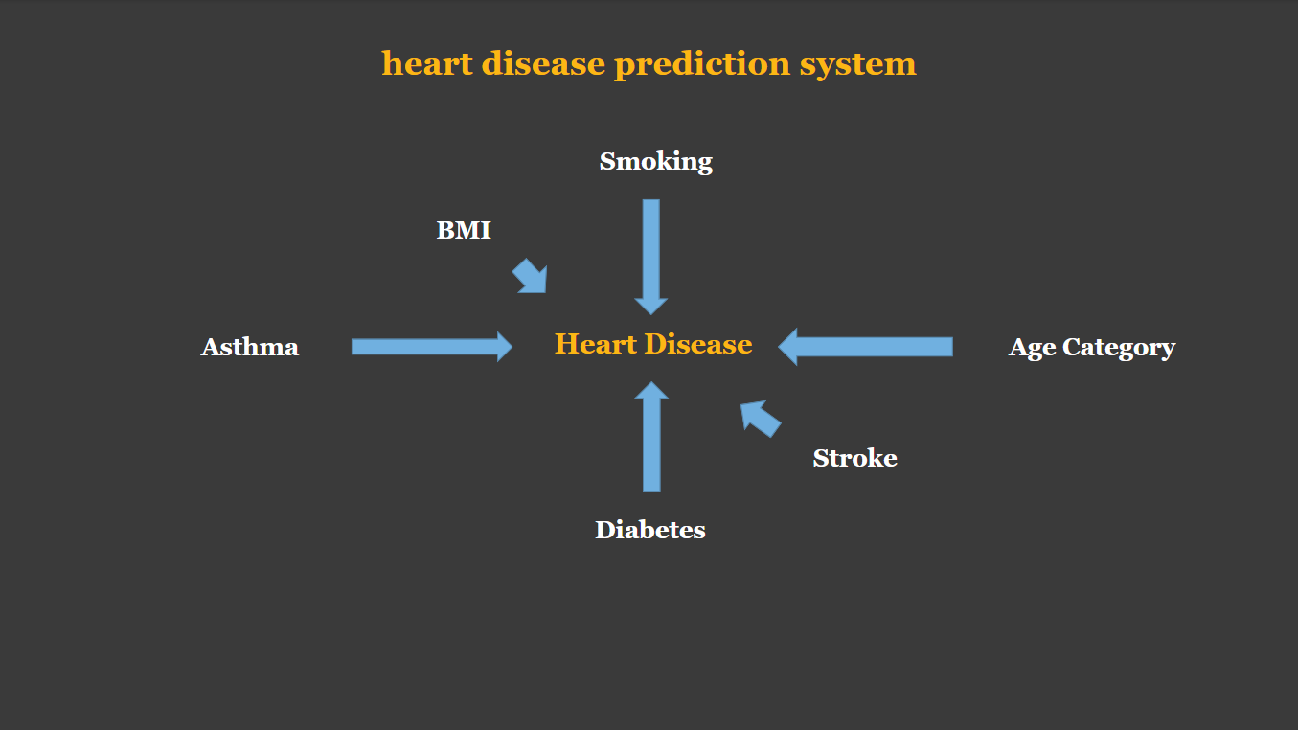

Slide 22
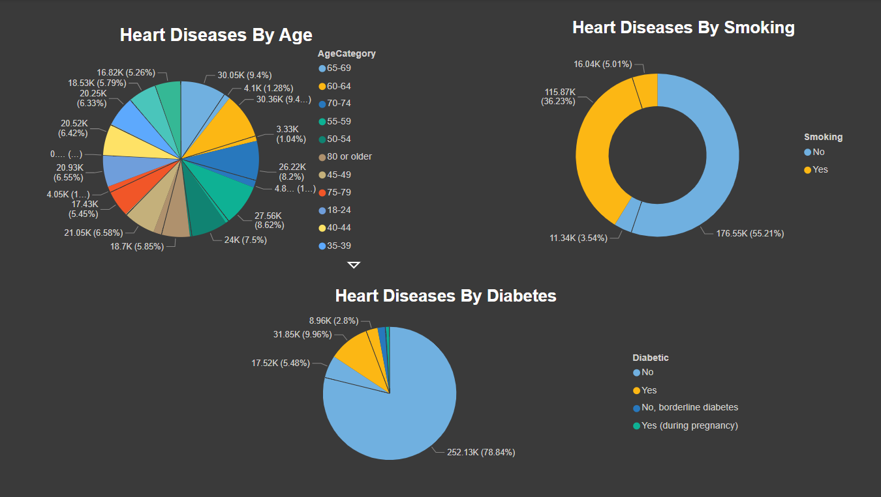

Slide 23
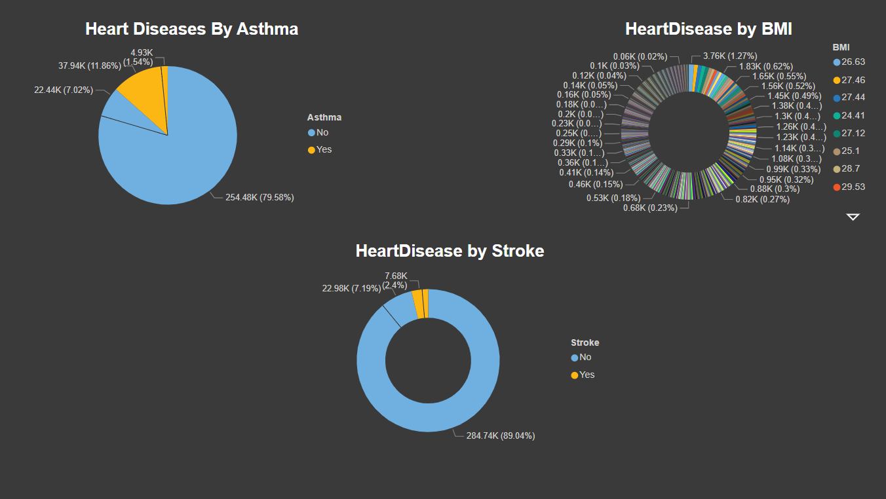

Slide 24
System
Workflow

Slide 25
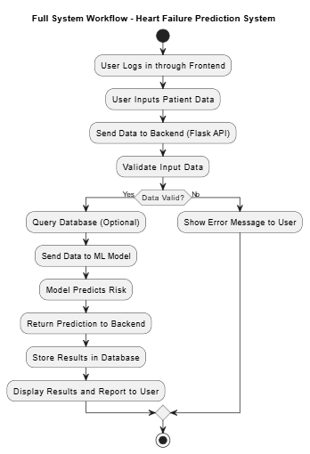

System Workflow
This flowchart illustrates the complete workflow of the Heart Failure Prediction System, from user input to prediction generation and result display."

Slide 26
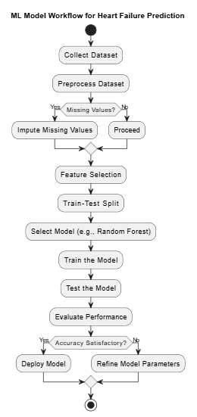

Machine Learning Workflow
This flowchart demonstrates the key steps in preparing, training, and evaluating the machine learning model, including data preprocessing, model selection, and performance evaluation.

Slide 27
Algorithm
Selection

Slide 28
Algorithm Selection
01
Logistic Regression
02
XGBoost
03
04
SVC
Decision Tree
05
06
KNeighborsClassifier
RandomForest

Slide 29
GUI Design

Slide 30

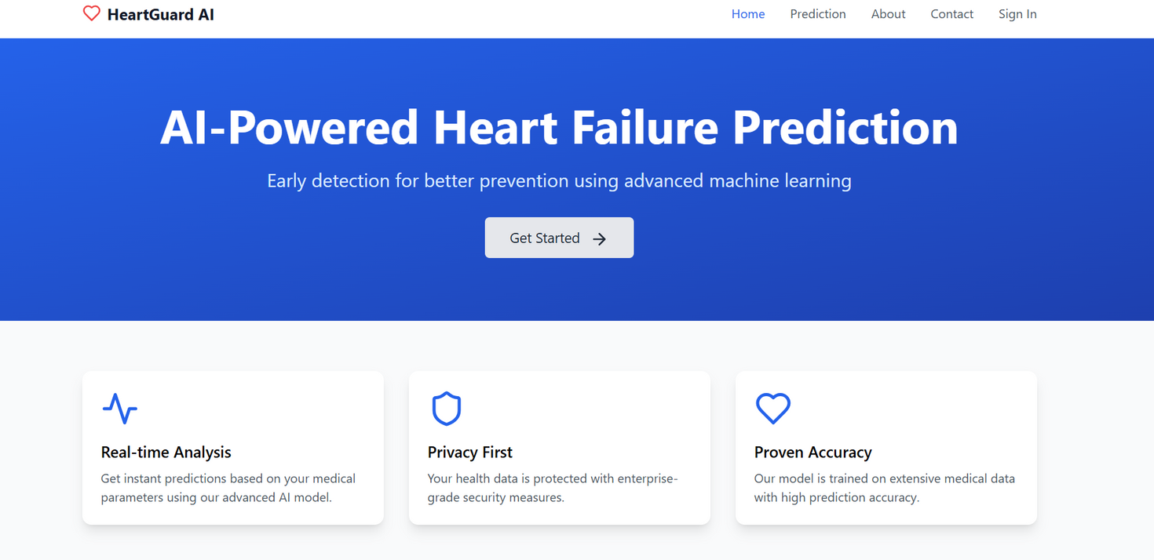
UI Design
2025

Slide 31
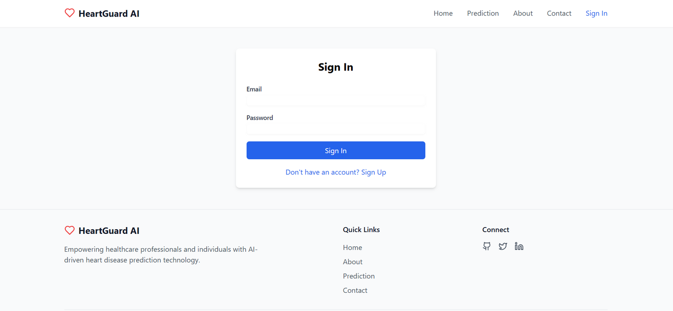
UI Design
2025

Slide 32
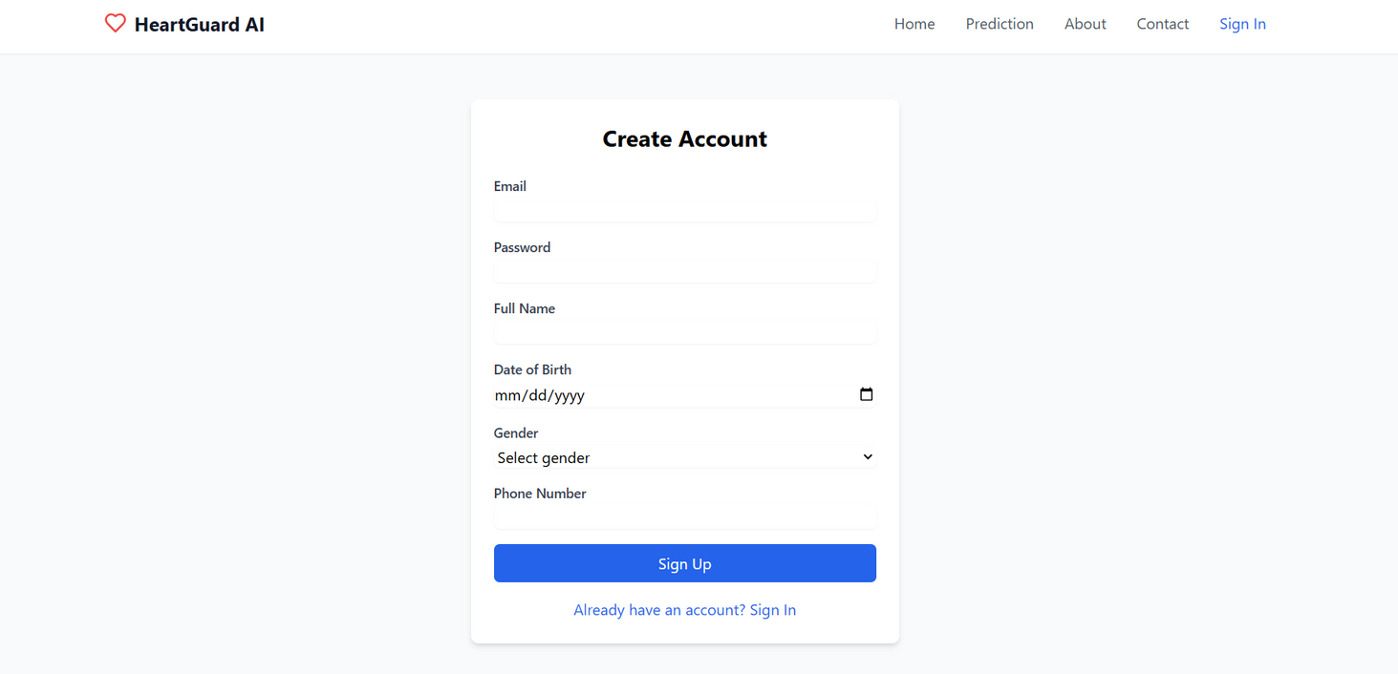
UI Design
2025

Slide 33
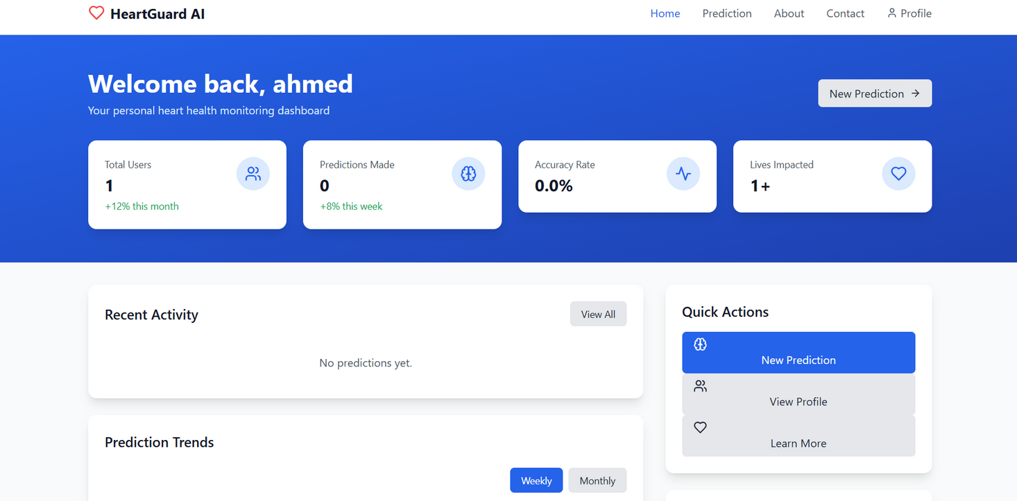
UI Design
2025

Slide 34
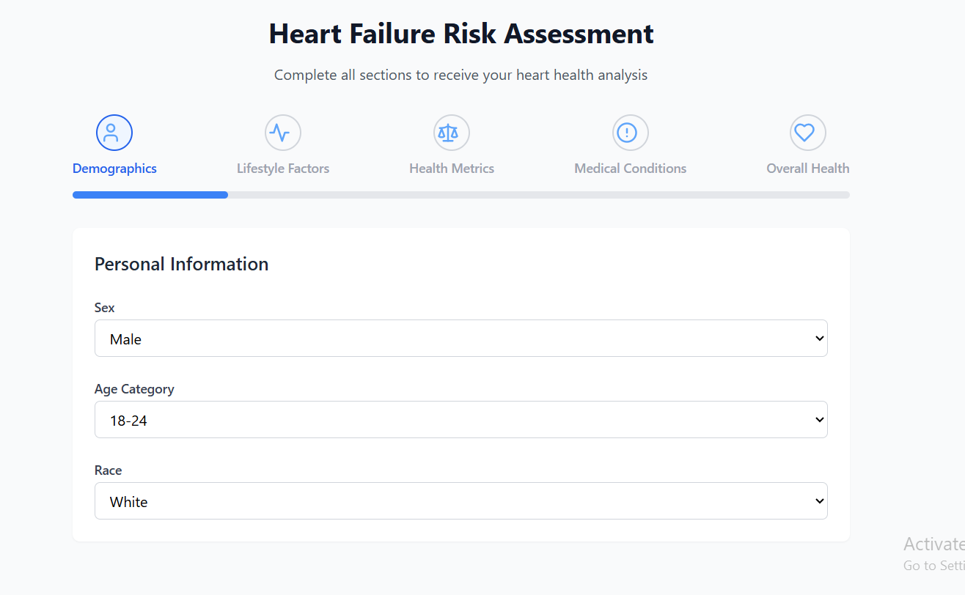
UI Design
2025

Slide 35
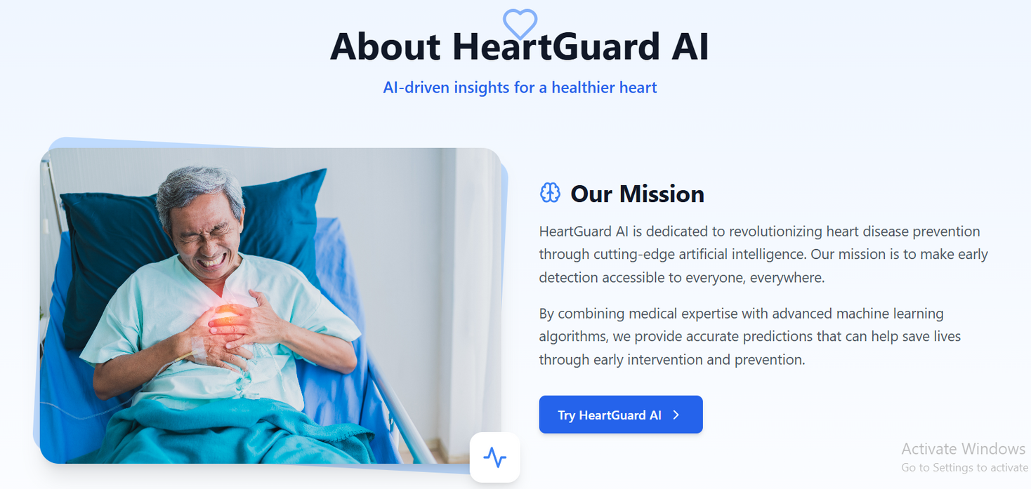
UI Design
2025

Slide 36
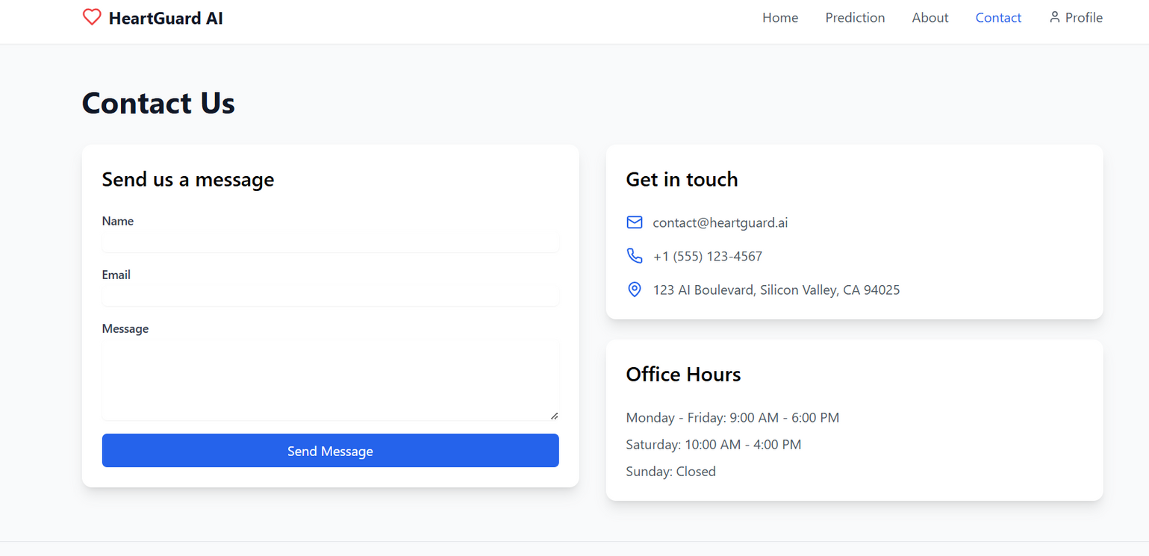
UI Design
2025

Slide 37
System Implementation

Slide 38











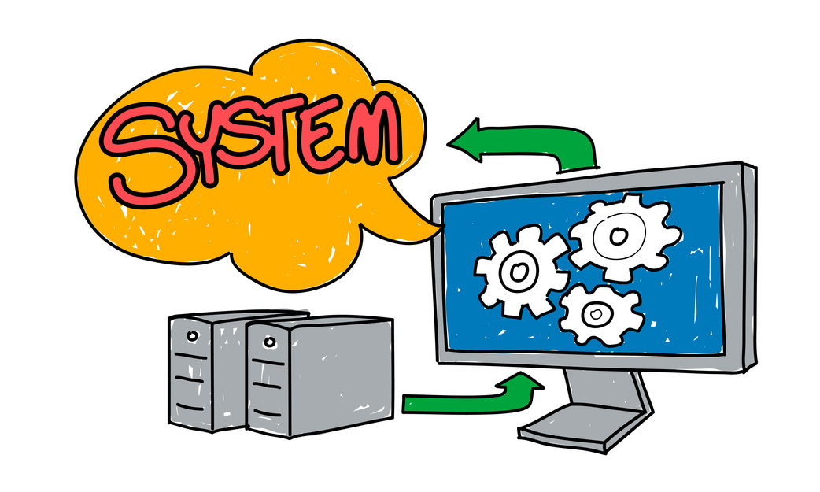
1
5
Frontend Development
Supabase Integration
React.js
TypeScript
Tailwind CSS
authentication and data storage
store Prediction results
tracking predictions by user
System Implementation
2
Machine Learning Model
4
Additional Modules
trained on Google Colab
Model created using XGBoost
Preprocessing with scikit-learn tools
Exported as .pkl files and integrated via Flask API
3
ECG Analysis
Chatbot Assistant
Backend API (Flask)
Developed using Flask + Flask-CORS
loading the ML model and handling POST requests

Slide 39
Database Implementation

Slide 40
Database Implementation
In this project, Supabase was used to manage the database, ensuring secure storage and easy access to user and prediction data, while Supabase Auth enables secure user authentication. Data is inserted after predictions are made. Users can view their history through the dashboard, creating a complete feedback loop.

Slide 41





Supabase
Dashboard Integration
Provides real-time, scalable PostgreSQL database for storing prediction results and user data
Predictions Table
Prediction history is displayed in the user dashboard for better tracking and insight.
Stores user data (e.g., BMI, smoking, age) and prediction results (low/high risk)
User Authentication
Data Insertion
Manages secure login and access to user-specific data
Prediction results are stored in the database and can be retrieved for user viewing.

Slide 42
System Testing
Testing ensured the system works correctly, is user-friendly, and meets its goals through various methods, including frontend, backend, ML model, and database testing, along with heuristic and cooperative evaluations.

Slide 43
Testing Approaches
Heuristic Evaluation: Checked UI based on usability rules to spot design issues.
Cooperative Evaluation: Users tested the system and gave direct feedback.
Functional Testing: Verified each feature works as expected.
Validation of Requirements: Ensured the system meets all planned goals.

Slide 44
System Installation

Slide 45




Installation Steps
step 3:
step 1:
pip install -r requirements.txt
Install Node.js and Python
step 2:
Create backend virtual environment
step 6:
Run both backend and frontend servers locally.
step 4:
Add the trained machine learning model files.
step 5:
Configure environment variables for Supabase integration.

Slide 46
Conclusion
Our project aims to develop a heart failure prediction model to enhance early diagnosis and medical decisions. In the first semester, we analyzed data and identified key risk factors. Next, we will train the model, build a user-friendly platform, and validate its performance. With further development, this system could make a real impact in healthcare.

Slide 47


FUTURE WORK
real-time ECG signal processing
custom SQL database
Enhancing the chatbot
Deploying the system to the cloud
Adding multi-language support

Slide 48
References

Slide 49
REFERENCES
KAGGLE – PERSONAL KEY INDICATORS OF HEART DISEASE DATASET
https://www.kaggle.com/datasets/kamilpytlak/personal-key-indicators-of-heart-disease
SCIKIT-LEARN DOCUMENTATION – MACHINE LEARNING IN PYTHON
https://scikit-learn.org/
SCIKIT-LEARN DOCUMENTATION – MACHINE LEARNING IN PYTHON
https://flask.palletsprojects.com/en/stable/
SUPABASE – OPEN SOURCE FIREBASE ALTERNATIVE
https://scikit-learn.org/
REACT.JS OFFICIAL DOCUMENTATION – JAVASCRIPT LIBRARY FOR UI
https://reactjs.org/

Slide 50
HEART FAILURE
The End

